Slide 1
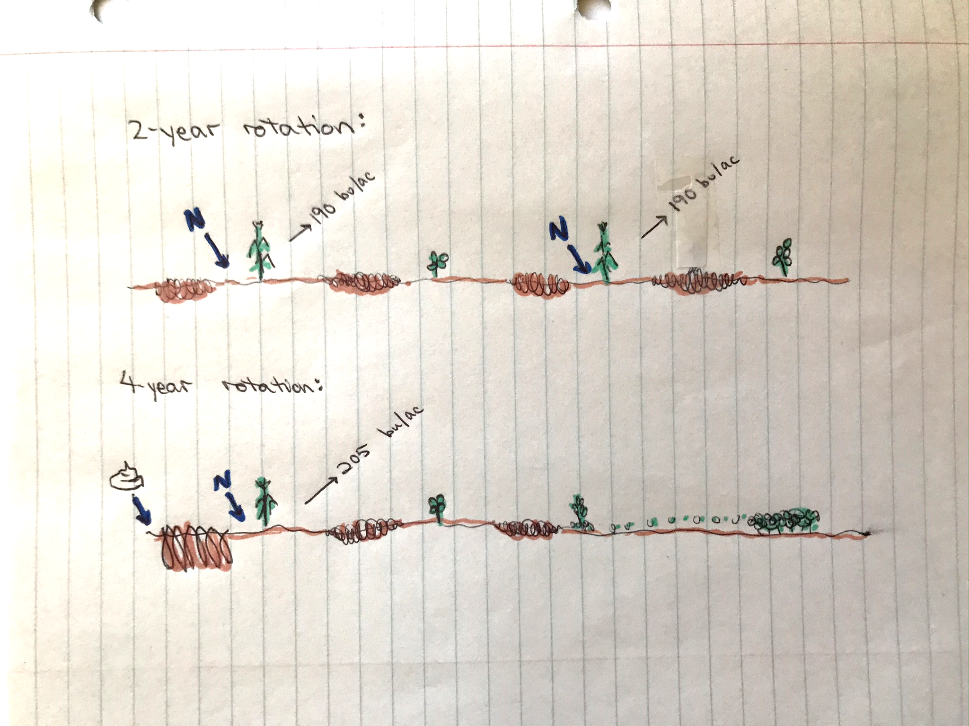

Slide 2
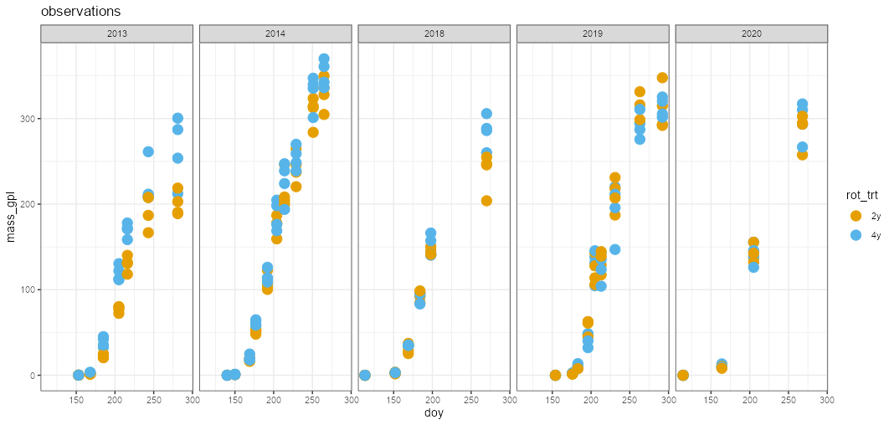

Slide 3
Biomass over time
Fit a logistic

Slide 4
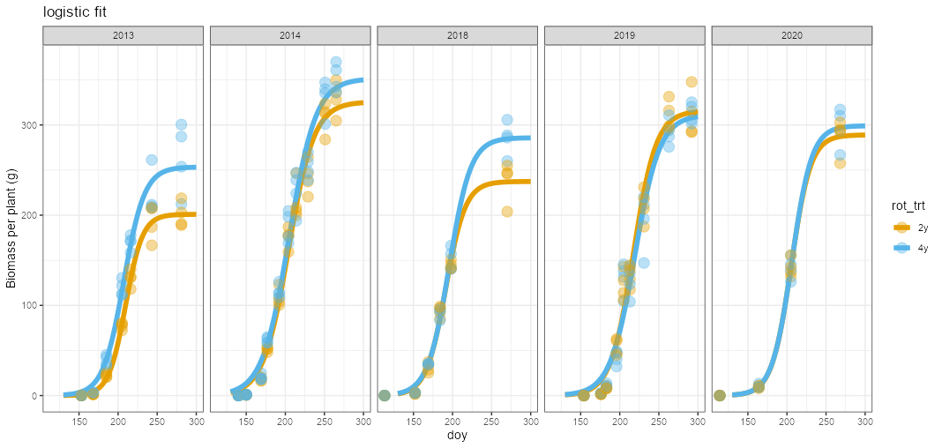

Slide 5
Biomass over time
Fit a logistic
Derivative is change in biomass/change in time
Growth rate (g per plant per day)

Slide 6
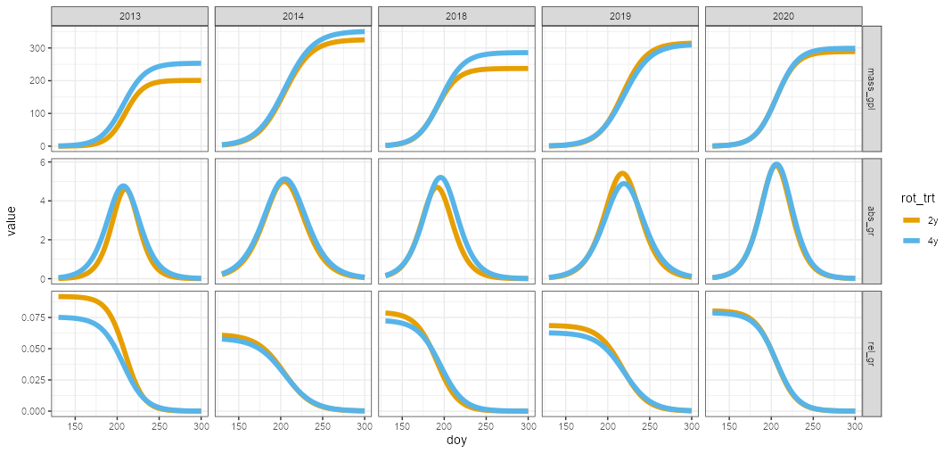

Slide 7
Biomass over time
Fit a logistic
Derivative is change in biomass/change in time
Growth rate (g per plant per day)
Growth rate divided by biomass
relative growth rate (g growth per day per g plant)

Slide 9
Biomass over time
Derivative is change in biomass/change in time
Growth rate (g per plant per day)
Growth rate divided by biomass
relative growth rate (g growth per day per g plant)
Radiation-use-efficiency is amount of biomass produced per unit of radiation intercepted
Divide biomass by LAI, take ratio of two systems

Slide 10
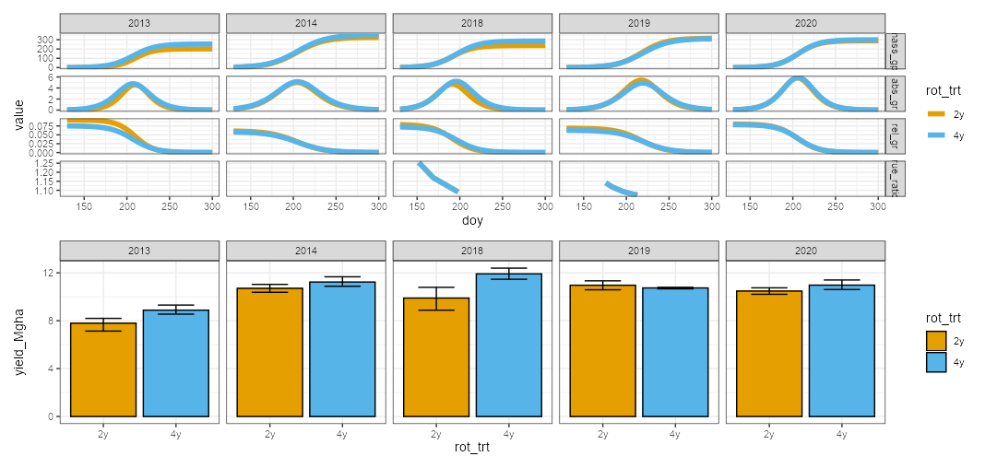

Slide 11
Total biomass differences reflective of yield differences
4yr growth rate is higher, but timing is inconsistent
2yr rotation corn has larger relative growth rates

Slide 12
Total biomass differences reflective of yield differences
4yr growth rate is higher, but timing is inconsistent
2yr rotation corn has larger relative growth rates
In 2018, the 4yr corn had bigger kernals

Slide 13
